Slide 1

BBA 3rd SEM 2023 – 2024
Strategy & Panchatantra
Submitted By-
Shankh Bansal
AU22C1013
Submitted To –
Dr. Harish Bapat

Slide 2

The tales of Panchatantra
The Panchatantra is a collection of stories. There are major of 5 types -
"Mitra Bheda" (Loss of Friends),
"Mitra Laabha" (Gaining Friends),
"Suhrud Bheda" (Causing Discord Between Friends),
"Vigraha" (Separation," and "Sandhi")

Slide 3
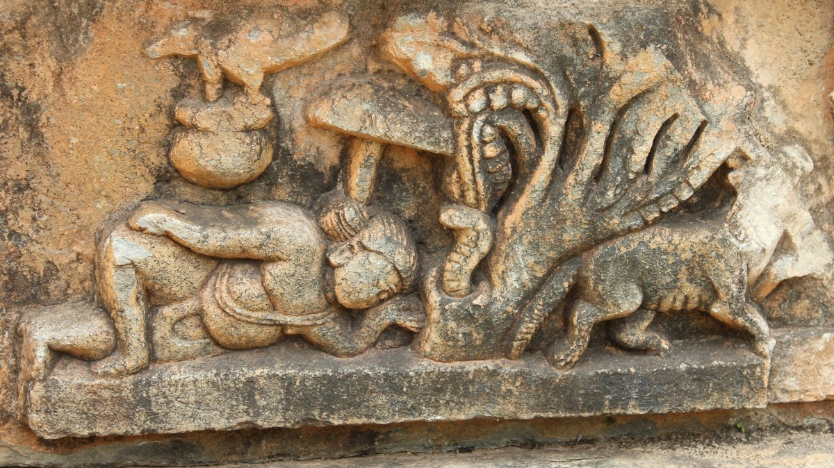
About Panchatantra
The Panchatantra represents significant fables about animal customs. According to Indian legend, Vishnu Sharma wrote the Panchatantra and submitted it as a Niti sastra. Sastra is regarded as a treatise on political science and ethical behavior, and niti is essential to "the judicious conduct of life."

Slide 4

The Story
A Hare was making fun of the Tortoise one day for being so slow.
The Hare was much amused at the idea of running a race with the Tortoise, but for the fun of the thing he agreed. So the Fox, who had consented to act as judge, marked the distance and started the runners off.
The Hare was soon far out of sight, and to make the Tortoise feel very deeply how ridiculous it was for him to try a race with a Hare, he lay down beside the course to take a nap until the Tortoise should catch up.
The Tortoise meanwhile kept going slowly but steadily, and, after a time, passed the place where the Hare was sleeping. But the Hare slept on very peacefully; and when at last he did wake up, the Tortoise was near the goal. The Hare now ran his swiftest, but he could not overtake the Tortoise in time.

Slide 5
Moral of the story
01
02
03
“It’s good to be individually brilliant and to have strong core competencies; but unless you’re able to work in a team and harness each other’s core competencies
Fast and consistent will always beat the slow and steady. It’s good to be slow and steady; but it’s better to be fast and reliable.
First identify your core competency and then change the playing field to suit your core competency.

Slide 6
Moral of the story
02
03
01
“It’s good to be individually brilliant and to have strong core competencies; but unless you’re able to work in a team and harness each other’s core competencies
Fast and consistent will always beat the slow and steady. It’s good to be slow and steady; but it’s better to be fast and reliable.
First identify your core competency and then change the playing field to suit your core competency.

Slide 7
Moral of the story
03
01
02
“It’s good to be individually brilliant and to have strong core competencies; but unless you’re able to work in a team and harness each other’s core competencies
Fast and consistent will always beat the slow and steady. It’s good to be slow and steady; but it’s better to be fast and reliable.
First identify your core competency and then change the playing field to suit your core competency.

Slide 8
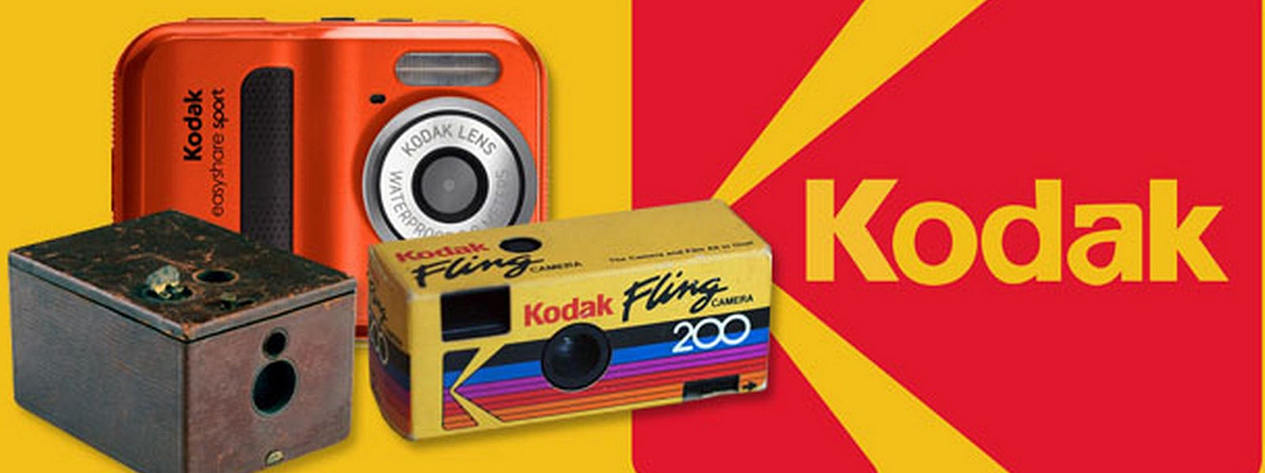
About Kodak
The history of the Kodak company is a fascinating journey that spans over a century and a half. Founded by George Eastman, Kodak is known for revolutionizing photography and making it accessible to the masses. Here's a brief overview of its history:

Slide 9

Founding and Early Years (1880s-1900s):
George Eastman founded the Eastman Dry Plate Company in 1880 to manufacture dry plates for photography.
In 1888, Eastman introduced the Kodak camera, which came pre-loaded with a roll of film that could capture 100 photographs.
The famous slogan "You press the button, we do the rest" accompanied the Kodak camera, highlighting its simplicity and accessibility.

Slide 10

Introduction of Flexible Film (1900s-1920s):
In 1889, Eastman renamed his company the Eastman Kodak Company.
Kodak played a crucial role in the development of flexible roll film, replacing glass plates and making photography more portable and convenient.
In 1935, Kodak introduced Kodachrome color film, marking a significant advancement in color photography.

Slide 11

Expansion and Diversification (1930s-1950s):
Kodak expanded its product range to include motion picture films, X-ray films, and other imaging products.
During World War II, Kodak was involved in producing various military materials and equipment.
In the 1950s, Kodak introduced the Brownie camera, a popular line of inexpensive cameras that contributed to the democratization of photography.

Slide 12

The war between Kodak & Fuji
The "war" between Kodak and Fuji refers to the intense competition and rivalry that emerged between Eastman Kodak Company (Kodak) and Fuji Photo Film Co., Ltd. (Fuji) in the global photography and imaging industry. This rivalry became particularly pronounced during the 1980s and 1990s. Here's an overview of the Kodak-Fuji rivalry:

Slide 13

The Rise of Fuji:
Fuji, based in Japan, had a strong domestic presence and began to expand internationally during the 1980s.
Fuji was able to compete effectively with Kodak by offering high-quality film products, innovative technologies, and competitive pricing.

Slide 14

Trade Disputes and Market Access:
A significant aspect of the rivalry was the trade disputes between the United States and Japan over the photographic film market.
The U.S. accused Japan of unfair trade practices, such as dumping photographic film in foreign markets at below-cost prices. This led to tensions between the two countries and affected the dynamics of the Kodak-Fuji competition.

Slide 15

Market Strategies:
Kodak had traditionally dominated the global photography market, but Fuji's competitive pricing and advancements in technology challenged Kodak's position.
Both companies engaged in aggressive marketing strategies, product innovation, and pricing wars to gain a larger share of the market.

Slide 16
Decline of Film and Digital Transition:
The rivalry between Kodak and Fuji became even more pronounced during the transition from traditional film to digital photography.
Both companies faced challenges in adapting to the digital age, but Kodak's struggles were more pronounced. Fuji was relatively quicker in embracing digital technology.

Slide 17
Outcome:
Fuji's more proactive approach to digital photography allowed it to transition more smoothly into the digital era.
Kodak faced financial difficulties and eventually filed for bankruptcy protection in 2012, marking a significant decline in its influence in the industry.

Slide 18

Digital Age and Challenges (1960s-2000s):
Kodak was a pioneer in digital photography technology, having developed some of the earliest digital cameras in the 1970s and 1980s.
However, Kodak faced challenges as the industry transitioned to digital photography. The company struggled to adapt to this new paradigm and faced stiff competition from other tech companies.
In 2012, Kodak filed for Chapter 11 bankruptcy protection, marking a significant turning point in its history.

Slide 19

Reorganization and Focus
After bankruptcy, Kodak restructured its operations and focused more on commercial and industrial imaging solutions, such as printing and packaging.
The company also explored new areas, such as pharmaceuticals, leveraging its expertise in chemical processes for medical purposes.
Kodak continues to exist as a company, though its prominence in the consumer photography market has diminished significantly due to the rise of digital photography and smartphones.

Slide 20
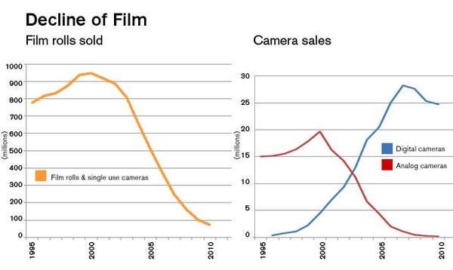

Slide 21
Learning from Kodak
01
02
03
“It’s good to be individually brilliant and to have strong core competencies; but unless you’re able to work in a team and harness each other’s core competencies
Fast and consistent will always beat the slow and steady. It’s good to be slow and steady; but it’s better to be fast and reliable.
Every competitive advantage has a limited lifespan.

Slide 22
Moral of the story
02
03
01
Fighting against the wrong competitors can kill your business.
Fast and consistent will always beat the slow and steady. It’s good to be slow and steady; but it’s better to be fast and reliable.
Every competitive
advantage has a limited lifespan.

Slide 23
Moral of the story
03
01
02
Fighting against the wrong competitors can kill your business.
Top management in reflecting listening about their blind spots.
Every competitive
Advantage has a
limited lifespan.

